Slide 1
CSE 575 Class Project Presentation Weather Forecasting
Team Members:
Balaji Sankar – 1209346459 - bsankar@asu.edu – 20% contribution
Karthik Subramanian – 1209360876 - ksubra19@asu.edu – 20% contribution
Aarti Rao Manjeshwar – 1209163211 - amanjesh@asu.edu – 20% contribution
Shwetha Narayanan – 1209166097 - snaray36@asu.edu – 20% contribution
Ramanathan Nachiappan – 1210822532 – rnachiap@asu.edu - 20% contribution

Slide 2
Overview
Introduction
Data Sets
Time Series Data modelling
Proposed approaches
Baseline - Naïve Persistence model
AR Modeling
ARIMA Modeling
LSTM
Nearest Neighbor Modeling
Results

Slide 3
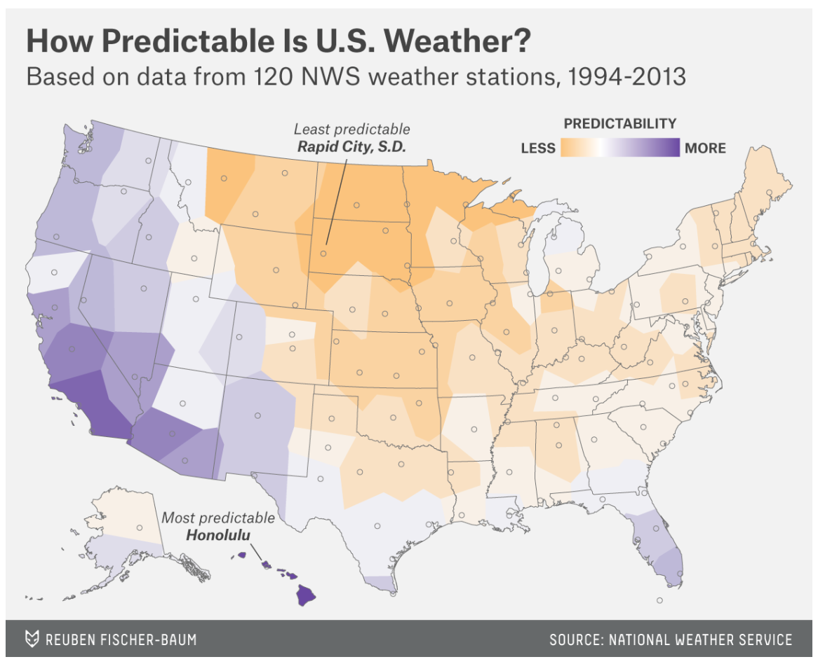

Slide 4
Data Sets
Source: http://www.noaa.gov/
National Oceanic and Atmospheric Administration by the U.S Department of Commerce
Data Set Sample:
Seattle, Dallas and Cincinnati weather data
Parameters – Sunrise, sunset, wind speed, precipitation, dew point, wet bulb temperature, pressure change, sky conditions etc. (52 features)

Slide 5
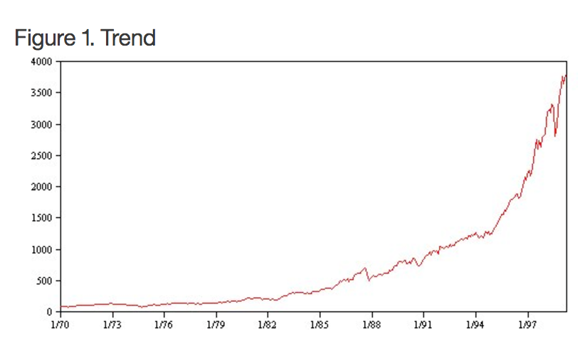
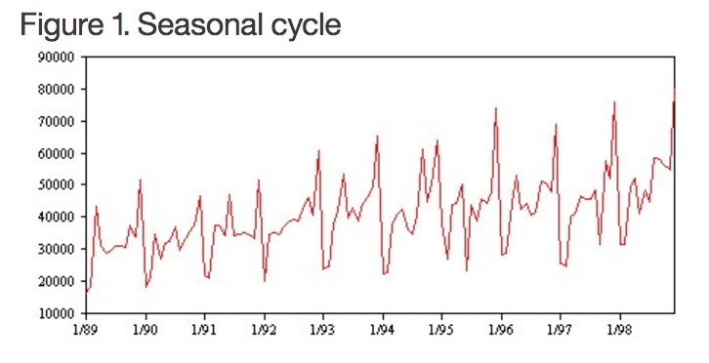
Time Series Characteristics

Slide 6
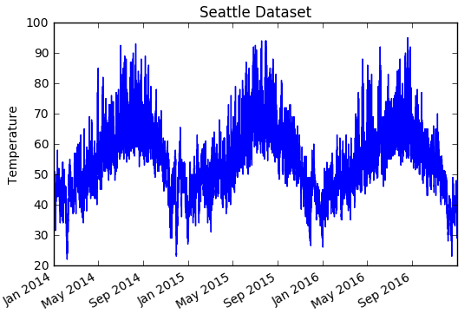
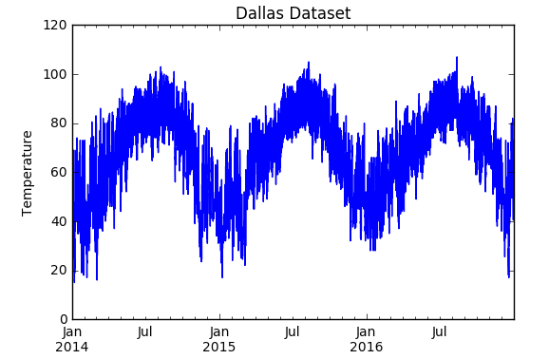
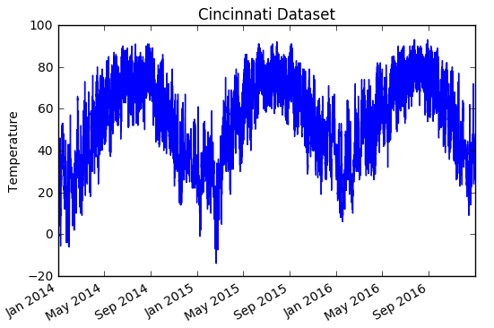
Weather is seasonal!

Slide 7
Baseline Prediction for Time Series
We used the persistence algorithm in establishing the baseline performance
Naïve Persistence Algorithm:
This algorithm uses the value at the previous time step t (input) to predict the outcome in the next time step t+1 (output)
Dataset split – Training -2/3rd and Testing – 1/3rd
This assumes nothing about the specifics about the time series to which it is applied, thus making it naïve and establishing a baseline performance

Slide 8
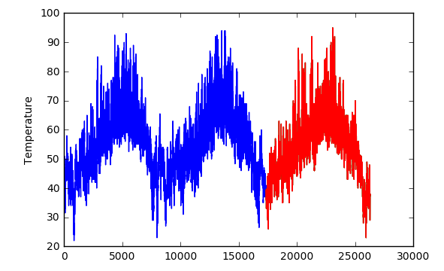
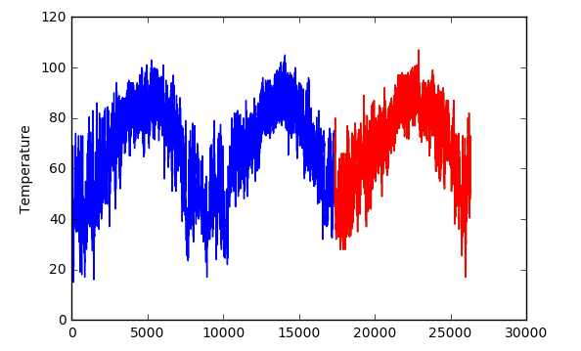
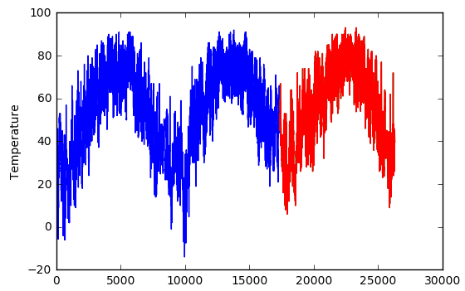
Predictions
Seattle
Dallas
Cincinnati

Slide 9
Proposed Approaches
AR
ARIMA Modeling
LSTM
Experimental Study: K Nearest Neighbor Modeling

Slide 10
AR Modeling
Similar to Baseline Prediction Model
Not Naïve Approach – Based on Linear Regression
X(t+1) = w0 + w1*X(t-1)
This relationship between variables is called correlation
Performed a correlation check for the two variables t+1 and t

Slide 11
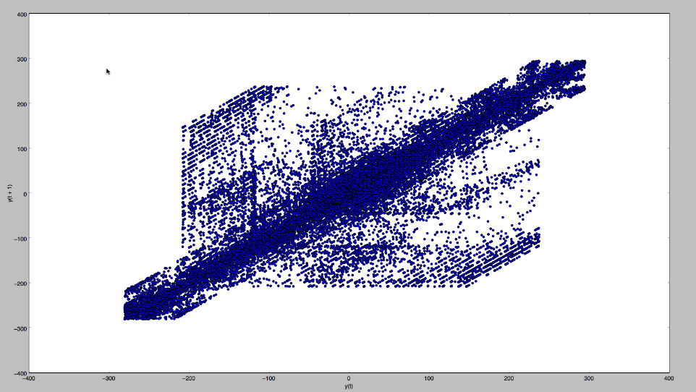
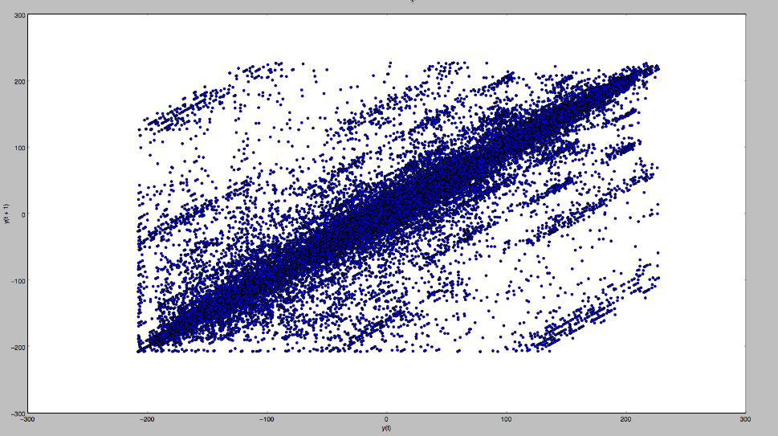
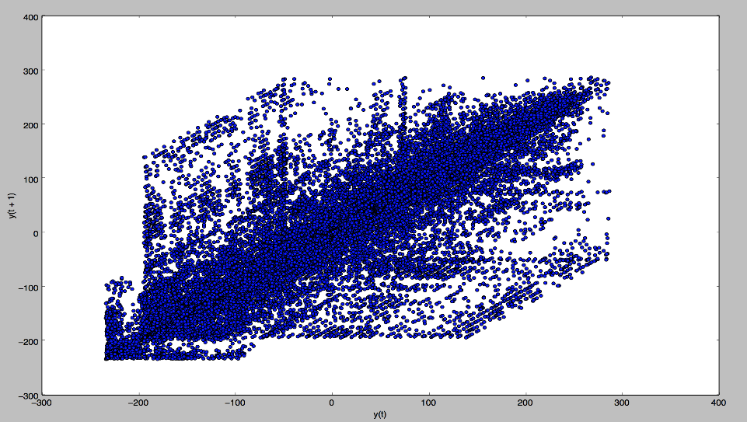
Correlation Check between t-1 and t+1
Seattle
Dallas
Cincinnati

Slide 12
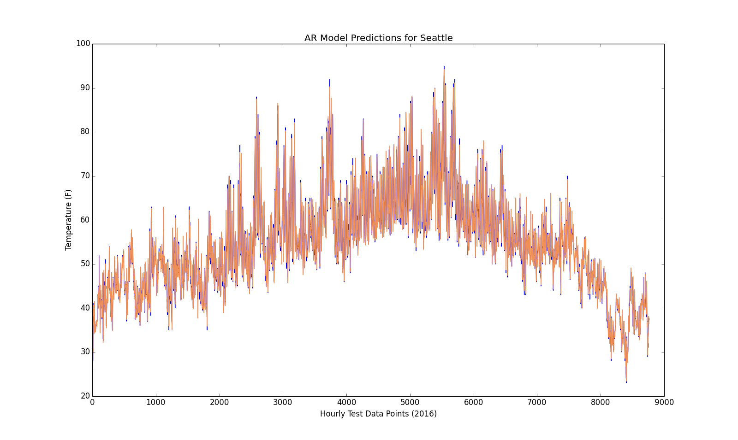
AR Results Seattle

Slide 13
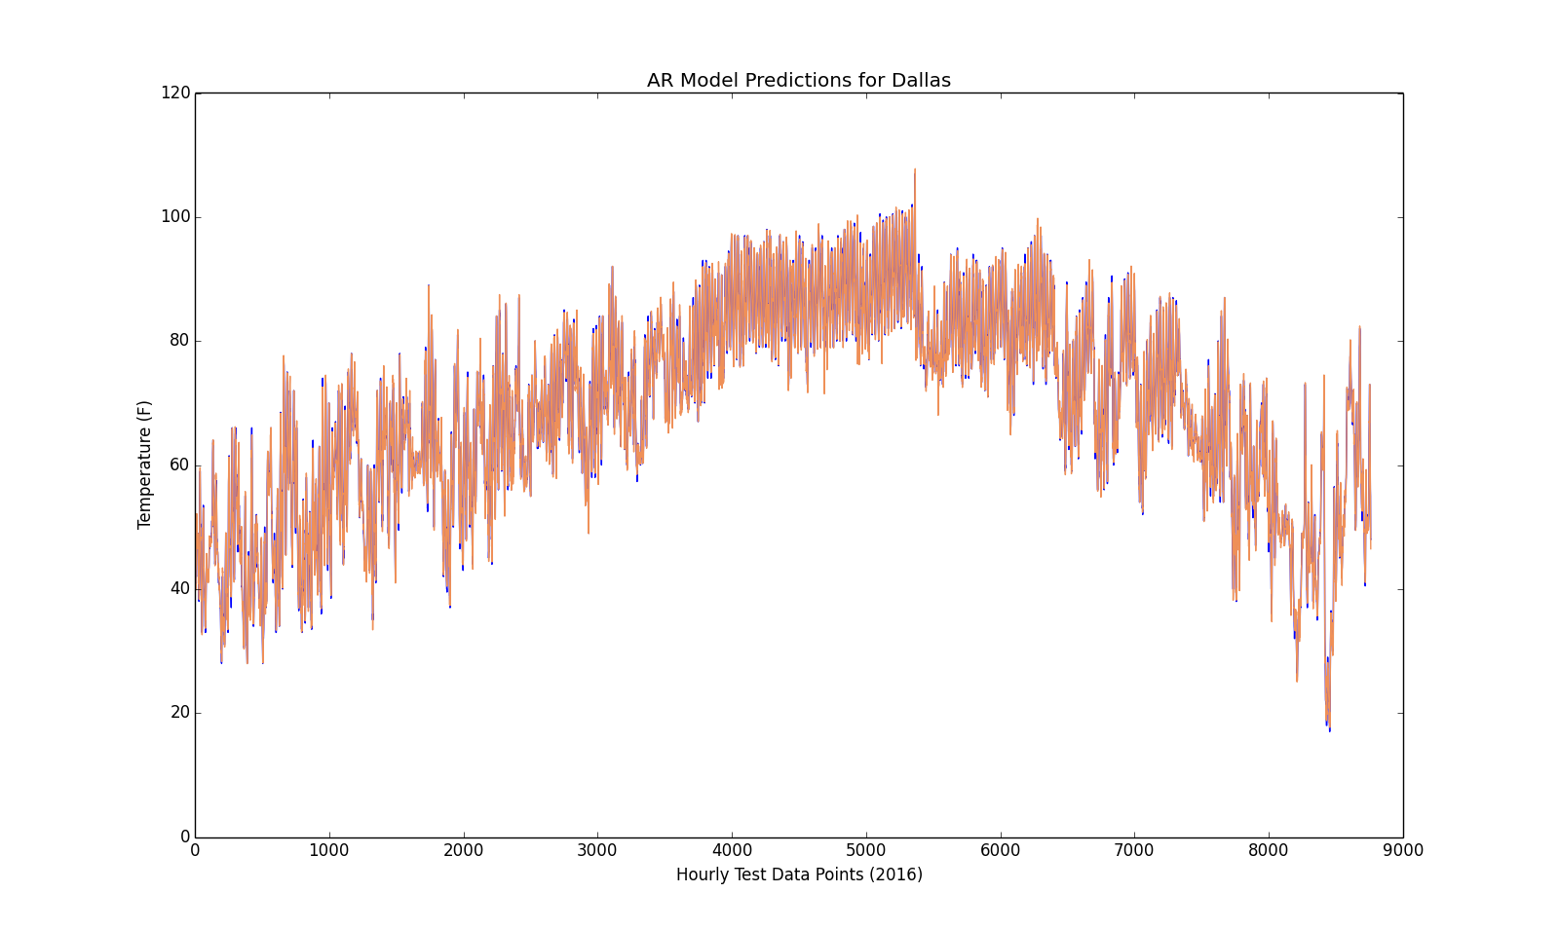
AR Results Dallas

Slide 14
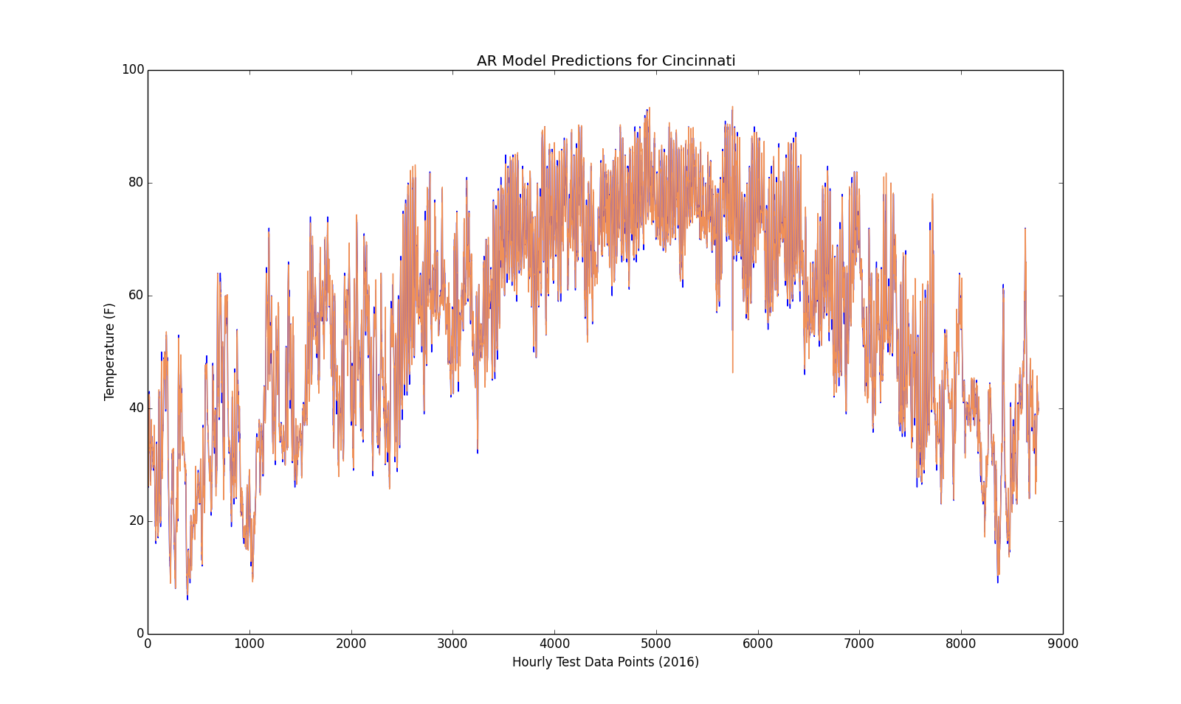
AR Results Cincinnati

Slide 15
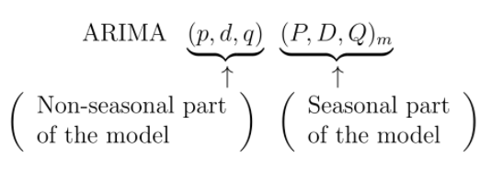
ARIMA
Combination of autoregressive (AR), integration (I) - and moving average (MA) operations.

Slide 16
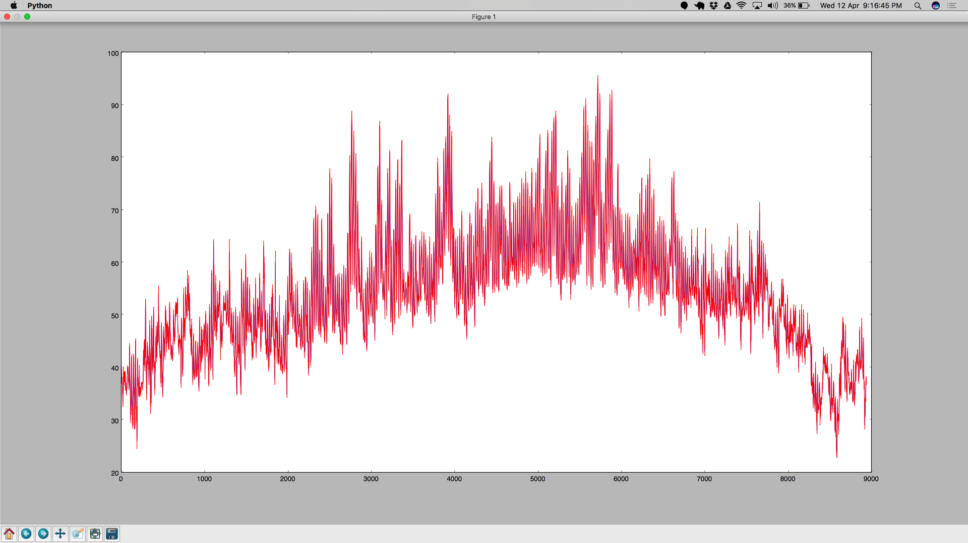
ARIMA Results Seattle

Slide 17
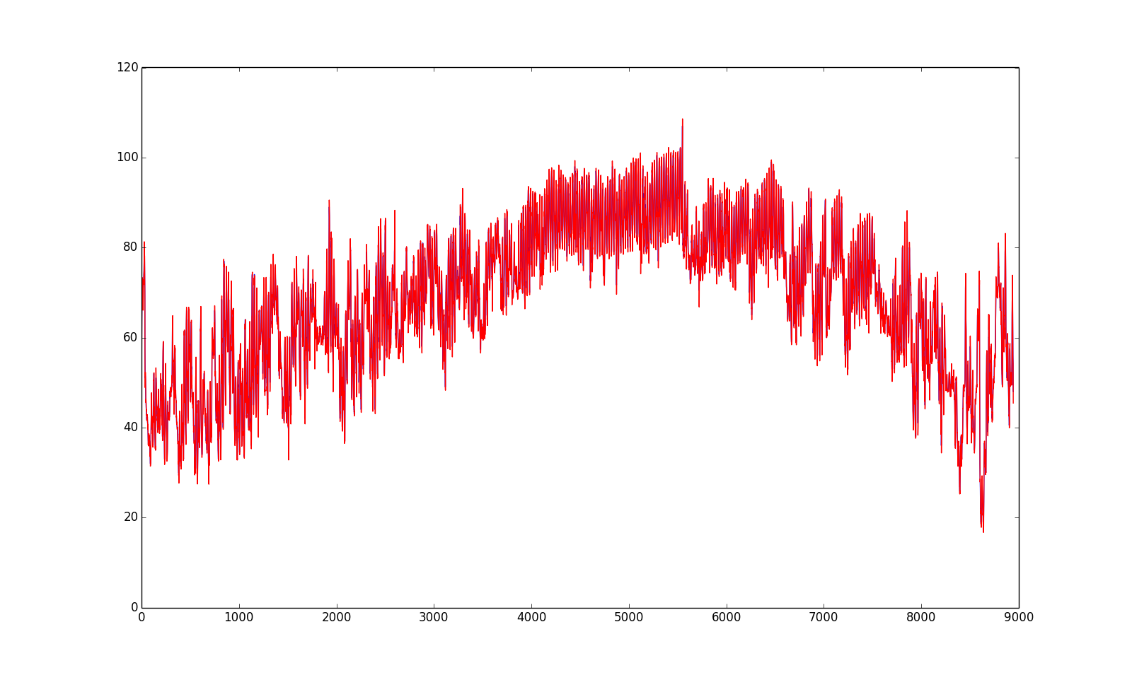
ARIMA Results Dallas

Slide 18
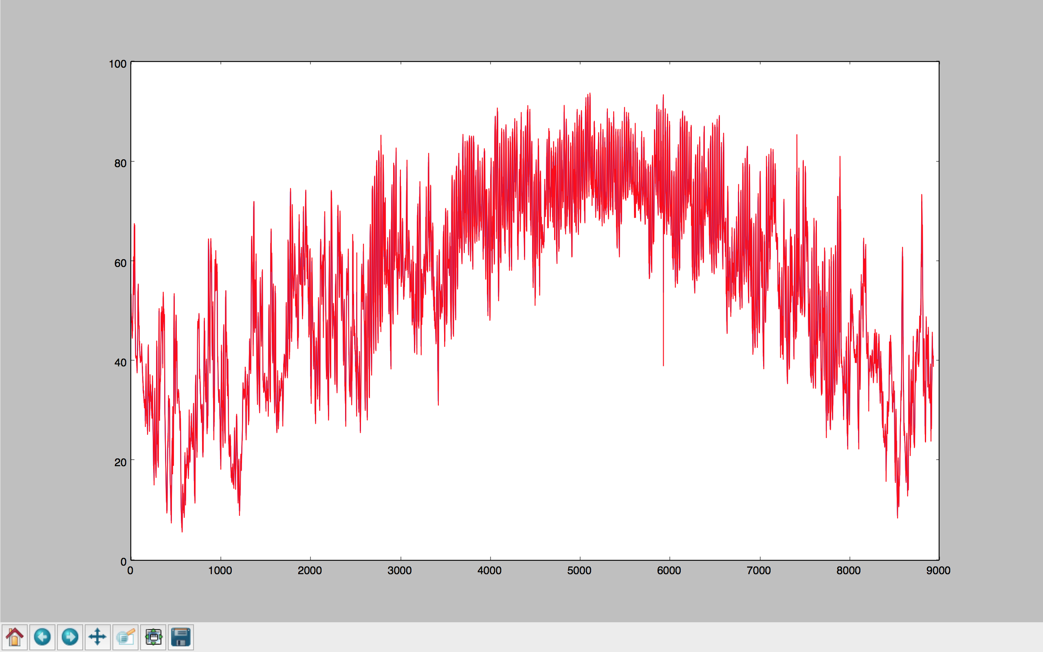
ARIMA Results Cincinnati

Slide 19

LSTM
It follows a recurrent neural network architecture.
Generally RNNs are good at remembering short term data
In our case, Weather is something that is repetitive (With respect to seasons).
LSTMs excel in this scenario, because it even considers the historical data that might be related to the present instant.
LSTM includes a forget gate, that throws away any information that is not needed. The rest are stored in the cell state.
We used “tanh” as our activation function.

Slide 20
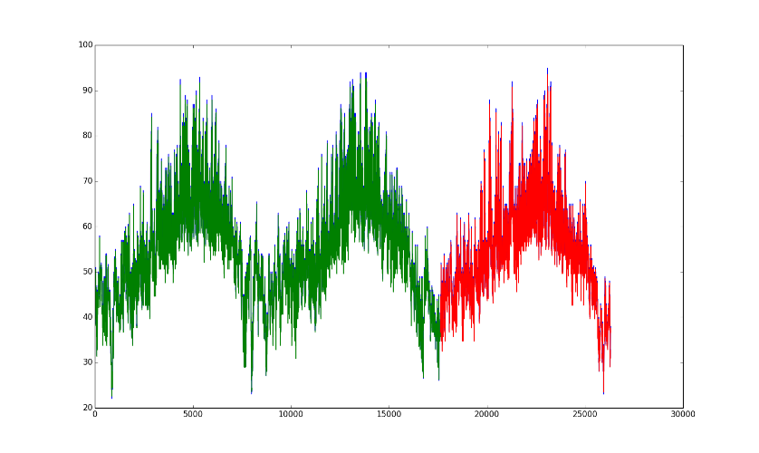
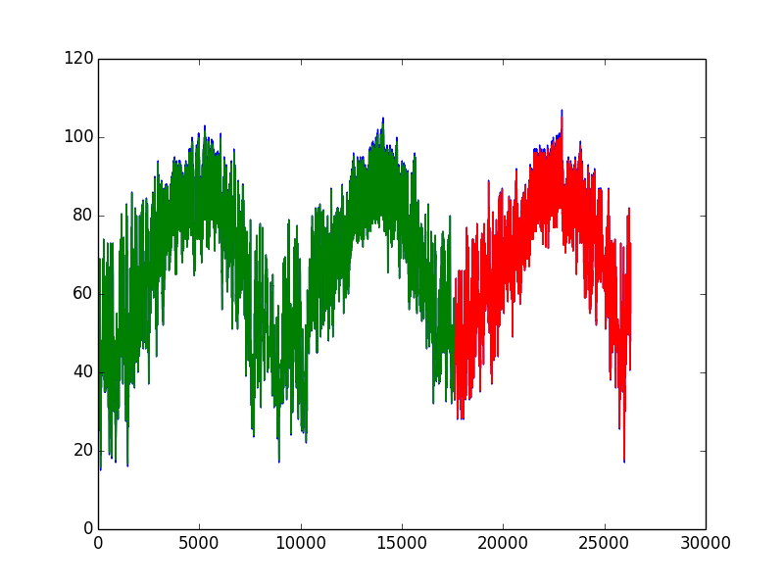
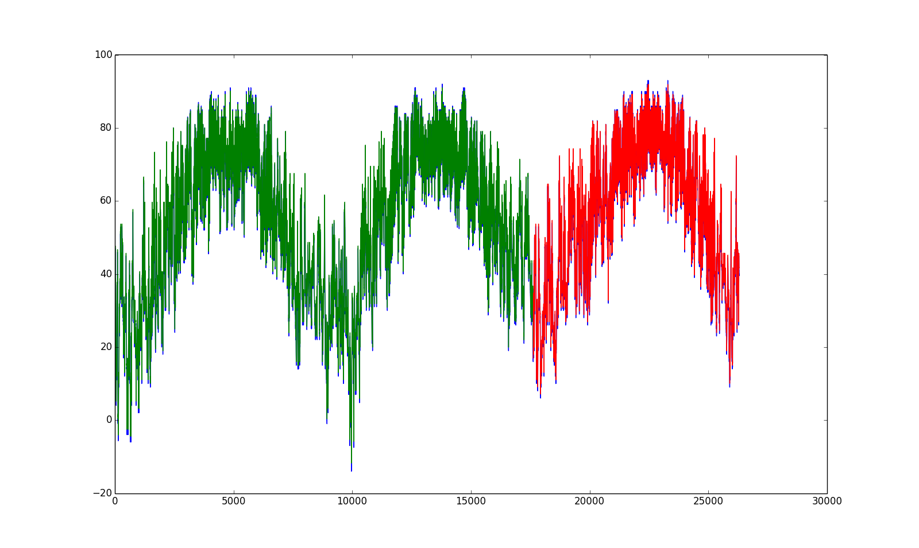
LSTM Predictions
Seattle
Dallas
Cincinnati

Slide 21
EXPERIMENTAL STUDY: KNN
Goal:
Indirectly predict the temperature for the next instant using KNN
Approach:
Using LSTM, predict the values of all the features which influences the temperature
Run KNN over this feature vector and return the mean of the nearest neighbors’ temperature

Slide 22
Recursive Feature Elimination using LR
Using PCA, we decided on the number of features to be 11 based on the feature variances.
We used Logistic Regression in our Recursive Feature Elimination process.
Our RFE kept eliminating features until we were left with only 11 features.

Slide 23
Logistic Regression for Feature Selection
Selected Features:
HOURLY ALTIMETER SETTING
HOURLY DEW POINT TEMPERATURE IN F
HOURLY PRESENT WEATHER TYPE – Snow, Rain etc.
HOURLY PRESSURE TENDENCY – Increase, decrease or no change in pressure over the last 3 hrs.
HOURLY RELATIVE HUMIDITY
HOURLY SEA LEVEL PRESSURE
HOURLY SKY CONDITIONS – Clear sky, few clouds, scattered clouds etc.
HOURLY STATION PRESSURE
HOURLY VISIBILITY
HOURLY WET BULB TEMPERATURE IN F
HOURLY WIND SPEED

Slide 24
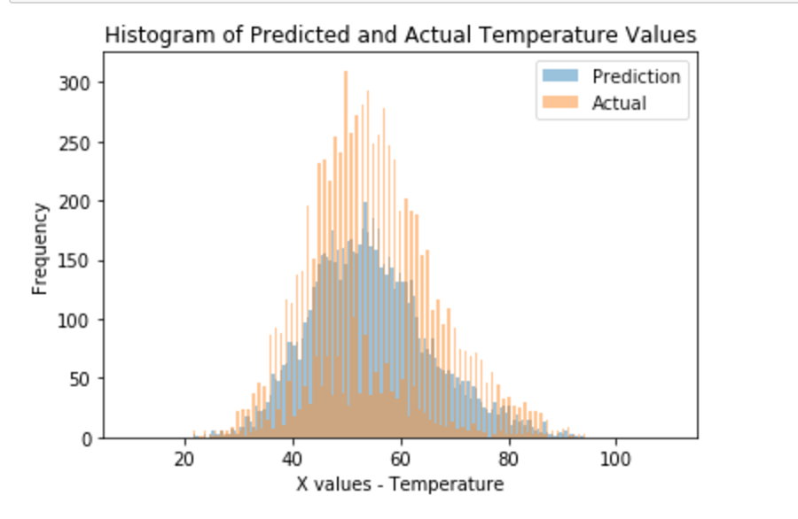
KNN Prediction Seattle

Slide 25
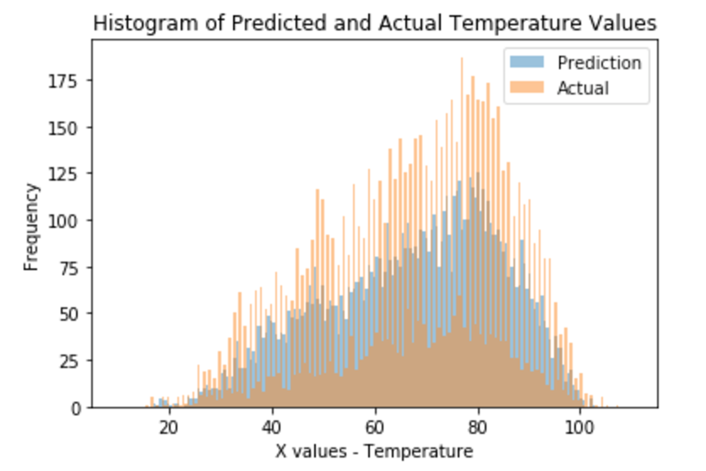
KNN Prediction Dallas

Slide 26
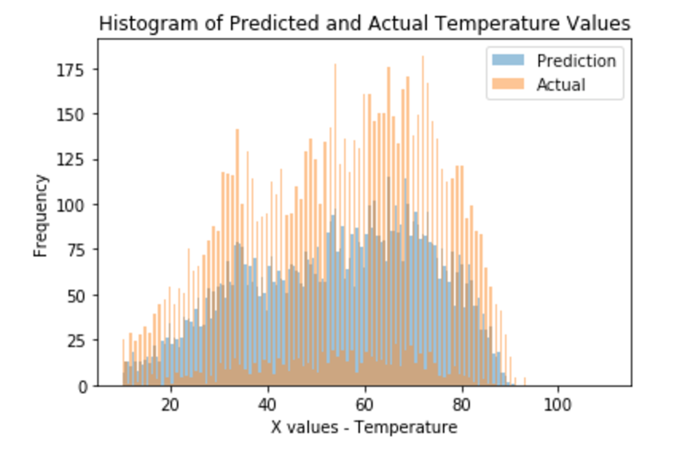
KNN Prediction Cincinnati

Slide 27
Results
Model | Seattle RMSE | Dallas RMSE | Cincinnati RMSE
Persistence | 1.78 | 2.14 | 2.58
AR | 1.37 | 1.54 | 2.06
ARIMA | 1.56 | 1.82 | 2.29
LSTM | 1.82 | 2.18 | 2.65
KNN (k=4) | 1.90 | 2.59 | 2.83
Inference:
AR and ARIMA perform better
Predictability: Seattle > Dallas > Cincinnati
ARIMA with external regressors does not improve the results because the historical value of the dependent variable itself has a greater significance

Slide 28
Thank You!
“All the team members agree on the team members’ contributions in terms of both (a) what s/he did and (b) the percentage”

Slide 29
Team Members
Balaji Sankar – 1209346459 - bsankar@asu.edu – 20% contribution
Karthik Subramanian – 1209360876 - ksubra19@asu.edu – 20% contribution
Aarti Rao Manjeshwar – 1209163211 - amanjesh@asu.edu – 20% contribution
Shwetha Narayanan – 1209166097 - snaray36@asu.edu – 20% contribution
Ramanathan Nachiappan – 1210822532 – rnachiap@asu.edu - 20% contribution
“All the team members agree on the team members’ contributions in terms of both (a) what s/he did and (b) the percentage”

